Slide 1
PSY3011S EXAM
Date: FRIDAY 28TH OCTOBER
Time: 2.00 pm
Duration: 2 HOURS
Venues: SPORTS CENTRE 1 (CHECK FOR VENUE CHANGES)
BRING YOUR STUDENT CARD

Slide 2
PSY3011S EXAM
Covering fourth term work only.
Section A:
Short answer questions, worth between 1-4 marks each.
Total of 30 marks.
You must answer all of these.
Section B:
You must answer 2 essay questions out of a choice of 4.
Each essay is worth 25 marks; total of 50 marks for Section B.

Slide 3
HOW TO STUDY
The exam is not setting out to trick you or trip you up. It aims to allow you to show what you know.
Focus on learning the content of the lecture slides and refer to your notes from the lectures to help you explain the content of the slides.
If there is something in the lecture material that you do not understand, use the readings to help you. But do not try to study the readings - the exam questions will come directly from the lecture slides and not from the readings.
Familiarity with the Term 4 tuts may help you for some of the essay topics – just read through your tut assignments to remind you of the key issues.

Slide 4
SHORT ANSWER QUESTIONS
Write enough for the marks that have been allocated (e.g. if it’s a 2 mark question, offer two separate points in your answer)
Do not repeat yourself, and do not write anything that is not directly answering the question (e.g. don’t list the symptoms of a disorder if the question does not ask about this) - this will receive zero marks.
You can write in point/bullet form, but make sure you say enough so that your point is clear to the reader. If the reader does not understand the point you are making, you won’t get a mark for it.

Slide 5
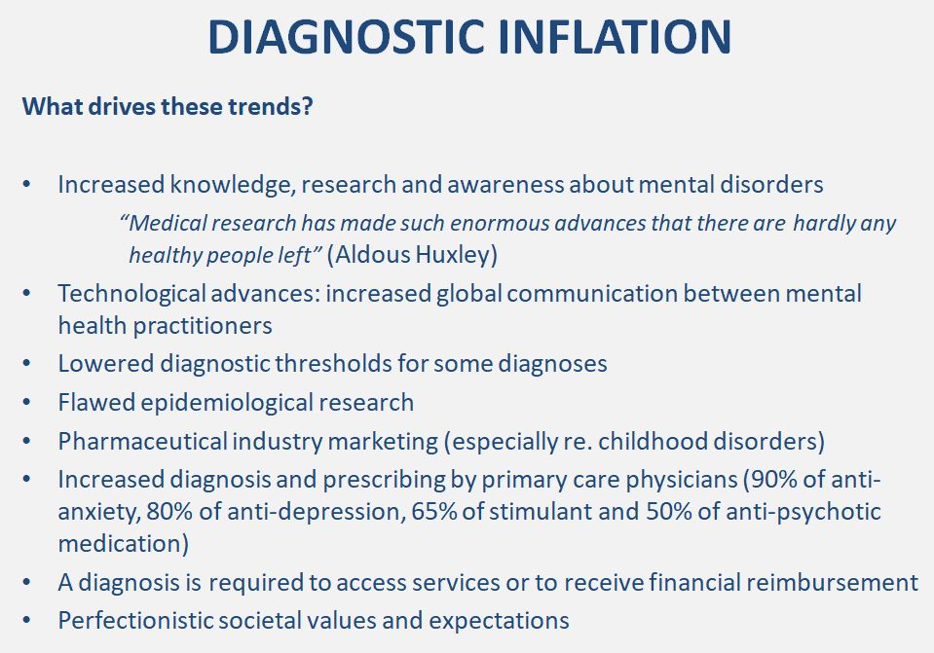
SHORT ANSWER QUESTIONS
Any two of
these:
Example:
Identify two factors that may drive the trend towards diagnostic inflation (2 marks).

Slide 6
ESSAY QUESTIONS
Aim for a minimum length of two and a half pages per
essay
You do not need an intro or conclusion paragraph – just
start writing what you know about the topic.
Your response must reflect detailed knowledge of the course content, and an ability to APPLY the course content to address the essay question.
Answer the question – do not include irrelevant
information.
Answer all aspects of the question, do not address one
part of the question but leave out the others.
Do not repeat yourself. Just make as many unique points
as you can, and give examples to illustrate as you go.

